Slide 1

Testing & Evaluation
Milestone 5 done by: Mehraeel Philip, Fatema Milad, Sama Gehad, Marwan Ahmed,
Mo’men Mohie & Jana Mahdy

Slide 2
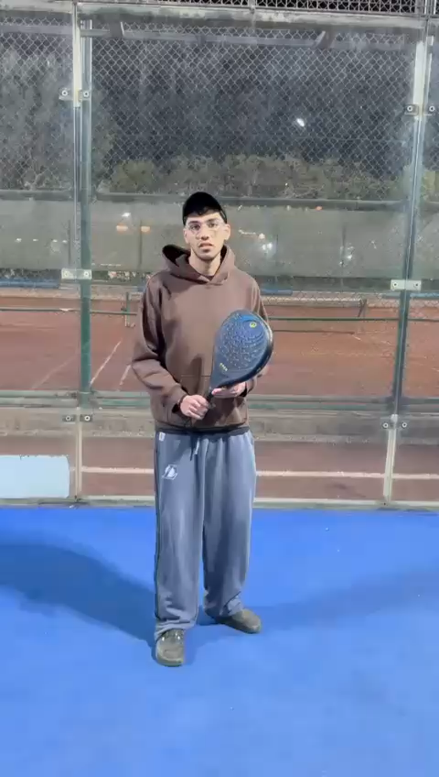
Acting Evaluation System Overview
Our system is an AI-based platform designed to automatically evaluate acting performances in a structured and objective way.
It takes a video of an actor as input and analyzes multiple performance aspects, including facial expressions, eye movement, voice activity, and body gestures. These features are extracted from each frame and processed using machine learning models.
The system then generates a detailed performance report that includes:
Emotion classification (e.g., happy, sad, neutral)
Gesture and movement analysis
Eye tracking and engagement scoring
Overall performance evaluation (Good, Moderate, Bad)
The goal of this system is to assist directors and evaluators by reducing human bias and providing consistent, data-driven feedback.

Slide 3
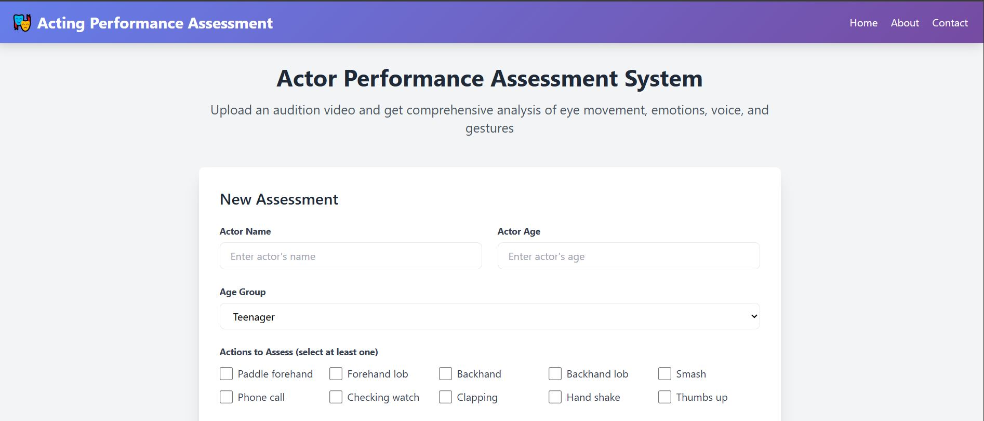
Challenges Addressed by the System
Traditional acting evaluation relies heavily on human judgment, which introduces several challenges.
First, evaluations are often subjective and depend on the evaluator’s mood, experience, and attention level, leading to inconsistent results.
Second, directors must assess multiple performance aspects simultaneously, such as emotions, gestures, and voice, which is difficult to do accurately in real time.
Third, handling a large number of audition candidates becomes time-consuming and inefficient, especially in professional casting environments.
Finally, analyzing continuous video data and identifying meaningful actions requires advanced processing techniques, such as action segmentation and classification.
Addressing these challenges by automating the evaluation process, analyzing multiple modalities simultaneously, and providing standardized and reliable performance assessments.

Slide 4
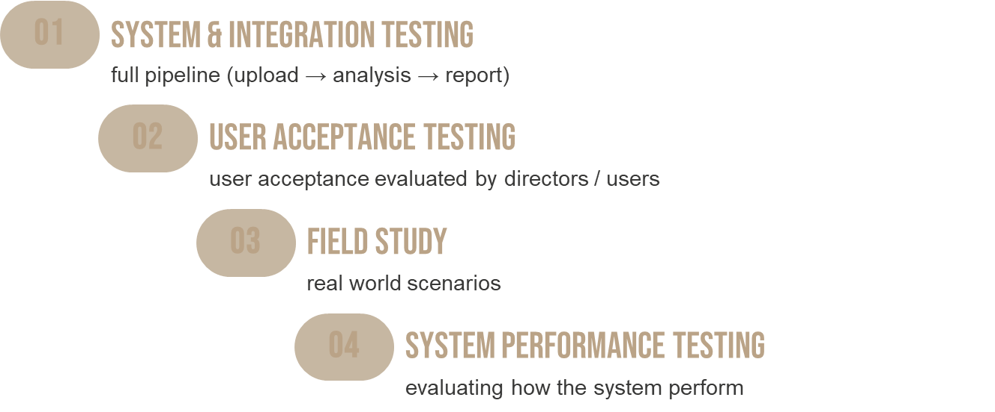
TESTING STRATEGY

Slide 5
A. Functional Cases
A1. Video Input
TEST ID | TEST CASE | STEPS | EXPECTED RESULT
TC-01 | File upload | Choose file | Accepts browsing
TC-02 | Frame Capture | Run system | Frames processed continuously
TC-03 | Invalid file type | Wrong fie input | Error handled gracefully
TC-04 | File ready to be processed | Start analysis | Load report

Slide 6
A. Functional Cases
A2. Emotion Detection
TEST ID | TEST CASE | EXPECTED RESULT
TC-05 | Happy face | "Happy" detected
TC-06 | Sad acting | "Sad" detected
TC-07 | Neutral | Neutral detected
TC-08 | Lighting change | Still detects correctly

Slide 7
A. Functional Cases
A3. Face and Eye Tracking
TEST ID | TEST CASE | EXPECTED RESULT
TC-09 | No face | No crash, no detection
TC-10 | Eye Tracking | Eye scoring and analysis
TC-11 | No voice | No crash, no detection
TC-12 | Multiple faces | Only one face tracked

Slide 8
A. Functional Cases
A4. Gesture Recognition
TEST ID | TEST CASE | EXPECTED RESULT
TC-13 | Known gesture | Correct classification
TC-14 | Unknown gesture | Rejected or low confidence
TC-15 | Speed variation | Still recognized
TC-16 | Noise input | No false positives

Slide 9
A6. Report Generation
TEST ID | TEST CASE | EXPECTED RESULT
TC-17 | Generate report | Output created
TC-18 | Printing report | Printed locally
TC19 | Score display | Numeric scores shown
TC-20 | Performance classification | Good, Moderate or Bad shown
TC-21 | Visualization | Widgets render
TC-22 | New analysis restart | Button accessible
TC-23 | Variables Classification | Independent variable scoring
TC-24 | Recommendations | Improvement advices

Slide 10
B. Non-Functional Cases
B1. Performance Testing
TEST ID | TEST CASE | EXPECTED RESULT
TC-25 | FPS (real-time) | ≥ 15 FPS
TC-26 | Processing delay | < 5000 ms
TC-27 | CPU usage | < 80%
TC-28 | Memory usage | Stable

Slide 11
B. Non-Functional Cases
B2. Usability Testing
TEST ID | TEST CASE | EXPECTED RESULT
TC-29 | First-time user | Can run without help
TC-30 | UI clarity | Buttons understandable
TC-31 | Report readability | Easy to interpret
TC-32 | Error messages | Clear

Slide 12
B. Non-Functional Cases
B3. Security Testing
TEST ID | TEST CASE | EXPECTED RESULT
TC-33 | Invalid file upload | Rejected
TC-34 | Large file | Handled safely
TC-35 | Data privacy | No external leaks
TC-36 | Path injection | Prevented

Slide 13
B. Non-Functional Cases
B4. Reliability Testing
TEST ID | TEST CASE | EXPECTED RESULT
TC-37 | Multiple runs | Stable
TC-38 | Restart system (Recovery) | Works again
TC-39 | Load testing | Expected user loads processed
TC-40 | Feature testing | Individual functions working
TC-41 | Endurance testing | Stable
TC-42 | Mean Time To Repair | < 1s

Slide 14
Usability testing
02

Slide 15
Testing plan
Measure:
Time to complete tasks
Number of errors
Task success rate
Participants: 5–10 users
User satisfaction

Slide 16
Metrics to Test Usability
Metric | Description | Results
Task Completion Rate | % of users completed task | 100 %
Time to Complete | Minutes | ~ 3 minutes
Error Count | Number of mistakes | 2 mistakes
User Satisfaction | Questionnaire | ~ score: 85
Use SUS (System Usability Scale)
Score range: 0–100
Passing score: ≥ 68
Example of feedbacks:
“The system was easy to use”
“I felt confident using the system”

Slide 17
Field study (REAL ENVIRONMENT TEST)
03

Slide 18
STRATEGY
Implementation
Data Collection
Findings
Upload video of performing scenes naturally.
Use the system for real auditions
Observations – Interviews - Video recordings upload- User feedback
Backend processing time, report accuracy
Actor feels stressed = gaze instability

Slide 19
Playwright Automated testing
04

Slide 20
=================================================================== test session starts ===================================================================
platform win32 -- Python 3.9.23, pytest-8.4.2, pluggy-1.6.0 -- C:\Graduation Project\V8\venv\Scripts\python.exe
cachedir: .pytest_cache
rootdir: C:\Graduation Project\V8\web_app\tests
plugins: anyio-4.12.1, dash-4.0.0, base-url-2.1.0, playwright-0.7.1, timeout-2.4.0
collected 16 items
test_app.py::TestFunctionalCases::test_A1_user_authentication_and_session PASSED
test_app.py::TestFunctionalCases::test_A2_report_generation_and_download PASSED
test_app.py::TestFunctionalCases::test_A3_report_content_validation PASSED
test_app.py::TestFunctionalCases::test_A4_report_history_and_retrieval PASSED
test_app.py::TestFunctionalCases::test_A5_performance_metrics_in_report PASSED
test_app.py::TestNonFunctionalCases::test_B1_page_load_time Page load time: 1752ms ✓
PASSED
test_app.py::TestNonFunctionalCases::test_B2_report_generation_time PASSED
test_app.py::TestNonFunctionalCases::test_B3_concurrent_report_requests FAILED
test_app.py::TestNonFunctionalCases::test_B4_api_response_time /api/reports: Not available
/api/performance-metrics: Not available
/api/user/history: Not available
PASSED
test_app.py::TestNonFunctionalCases::test_B5_database_query_performance Database query time: 542ms ✓
PASSED
test_app.py::TestReportQuality::test_report_emotion_summary_exists PASSED
test_app.py::TestReportQuality::test_report_recommendations_exist PASSED
test_app.py::TestReportQuality::test_report_download_formats PASSED
test_app.py::TestUsabilitySUS::test_sus_task_navigation ✓ SUS navigation test passed
PASSED
test_app.py::TestUsabilitySUS::test_sus_error_count Errors in workflow: 0 ✓
PASSED
test_app.py::test_backend_emotion_api Note: Backend emotion API endpoint not found - check implementation
PASSED

Slide 21
======================================================================== FAILURES =========================================================================
_______________________________________ TestNonFunctionalCases.test_B3_concurrent_report_requests _______________________________________
self = <test_app.TestNonFunctionalCases object at 0x000002ABFF2E9070>
def test_B3_concurrent_report_requests(self):
"""Test handling concurrent report requests"""
import concurrent.futures
def request_report():
try:
response = requests.get(f'{self.api_base}/api/generate-report', timeout=10)
return response.status_code == 200
except:
return False
# Simulate 5 concurrent report requests
with concurrent.futures.ThreadPoolExecutor(max_workers=5) as executor:
futures = [executor.submit(request_report) for _ in range(5)]
results = [f.result() for f in futures]
success_rate = sum(results) / len(results) * 100
> assert success_rate >= 80, f"Only {success_rate}% of concurrent requests succeeded"
E AssertionError: Only 0.0% of concurrent requests succeeded
E assert 0.0 >= 80
test_app.py:179: AssertionError
================================================================= short test summary info =================================================================
FAILED test_app.py::TestNonFunctionalCases::test_B3_concurrent_report_requests - AssertionError: Only 0.0% of concurrent requests succeeded
======================================================== 1 failed, 15 passed in 155.01s (0:02:35) =========================================================

Slide 22
System Performance Testing
05

Slide 23
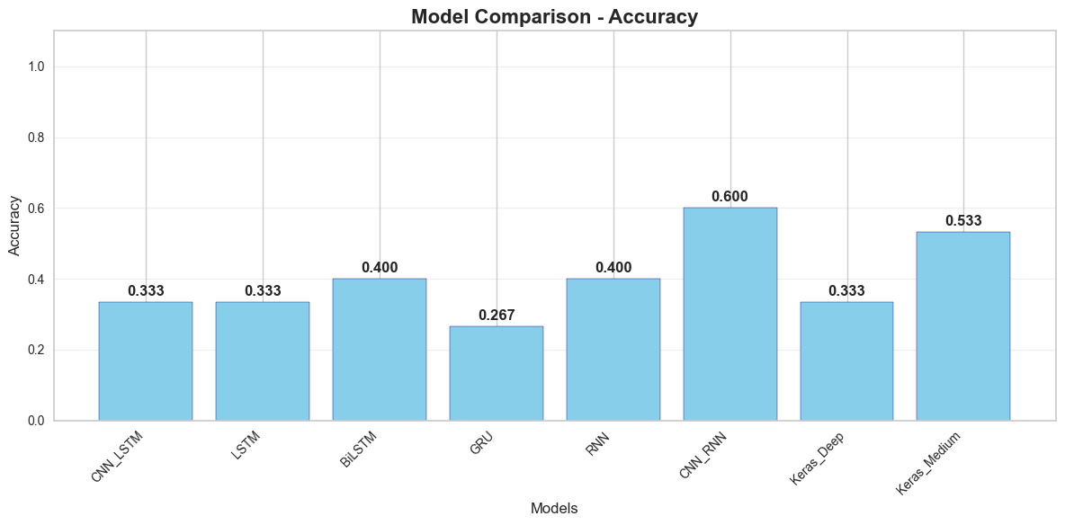
PREDICTED GROWTH

Slide 24
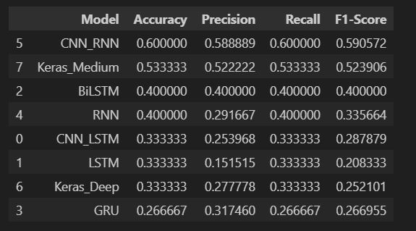
PREDICTED GROWTH

Slide 25
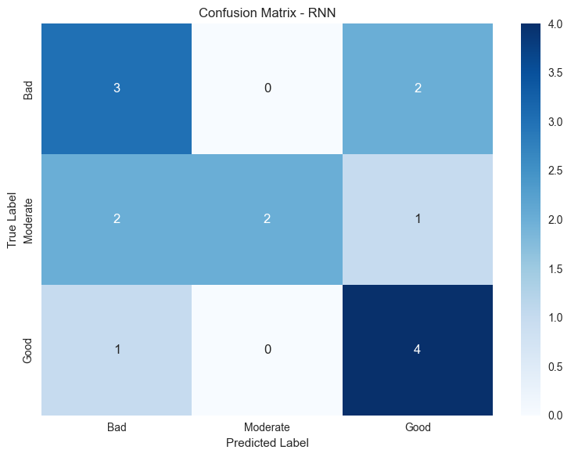
PREDICTED GROWTH

Slide 26
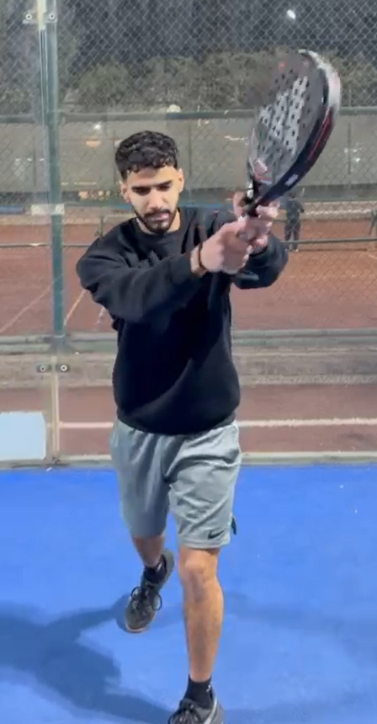
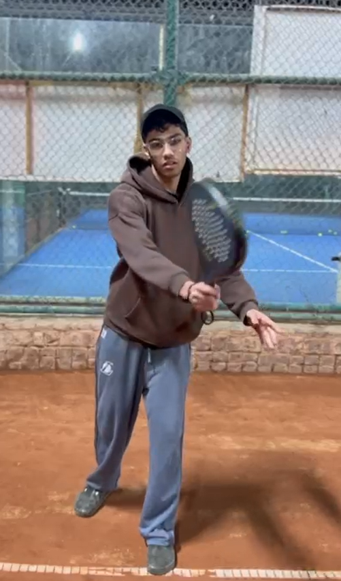

Good
Moderate
Bad

